Slide 1

ME222 PROJECT MASS BALANCE IN MULTI-PASS WELDING
VENKATESH KULKARNI
190103123

Slide 2
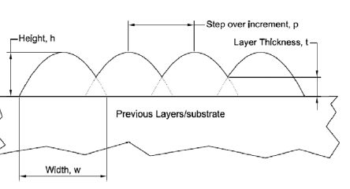
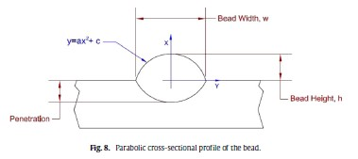
PROBLEM STATEMENT
Finding the height ‘h’ of the weld bead, assuming its cross sectional profile to be a parabola, for different paths in the 2D plane
Visualizing the results obtained using python library matplotlib, which would facilitate in optimizing the welding process.
Geometry of the weld bead
Parabolic cross sectional profile

Slide 3
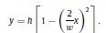
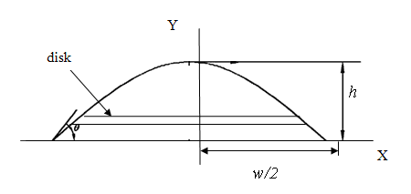
DEVELOPING THE MATHMATICAL MODEL
The equation of the weld bead in a single pass is assumed to be parabolic and the general equation is
Using the coordinate axes as shown in the figure below and the corresponding boundary conditions, we obtain the following equation
In order to simplify calculations, we shift the parabola to the right by a distance of width/2 and add the thickness of the weld bead to the equation. The equation we obtain is:
y = ax² + bx + c
y = (4h)/(w^(2))[wx-x^(2)] + t

Slide 4
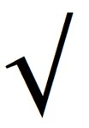
MATHEMATICAL MODEL CONTD.
But this equation is valid only for a 2D plane and the height will vary with both the abscissa and ordinate in the 3D coordinates
Hence we define a variable length and update it at each iteration
We use this variable length to define the height of the bead at the point (x[i], y[i])
We update length to zero whenever the length traversed along the curve exceeds the width of the bead
length += {(x[i+1]-x[i])**2 + (y[i+1]-y[i])**2}
z[i] = 4h/(w**2)*[w*length-length**2] + t
x[i], y[i] and z[i] represent the ith set of xyz coordinates
Note: Here s^2 is represented as s**2

Slide 5
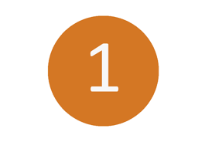
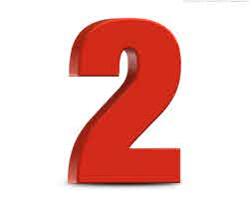
METHODS OF TAKING X,Y COORDINATES AS INPUT
Take the input from the x and y coordinates given in a csv file.
This is particularly useful when we want to generate complex curves in the x-y plane
However, one disadvantage is that we would need large number of points to generate a smooth curve in 3D
Define y as a function of x using the the numpy in python.
Simple functions like the exponentials, logarithmic, trigonometric, algebraic and products of these functions can be easily generated.
However, it is relatively difficult to define comlex functions

Slide 6
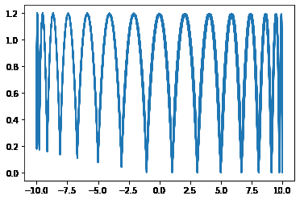
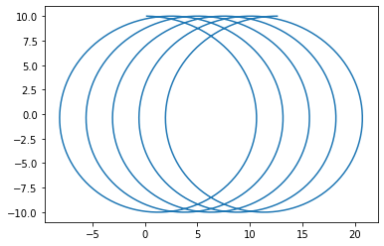
VISUALIZING THE RESULTS
Coordinates imported from the csv file
w=2mm, h=1mm, t=0.2mm
Graph of y vs x
Graph of z vs y

Slide 7
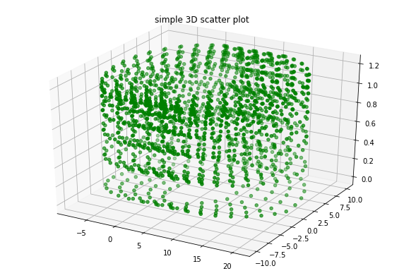
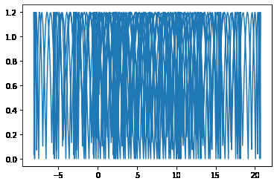
VISUALIZING THE RESULTS
Graph of z vs x
Plotting x,y,z in 3 dimensions
NOTE: Here due to the less number of sample points, the z-x and z-y 2D planes provide a better visualization of the height obtained than the 3D plot

Slide 8
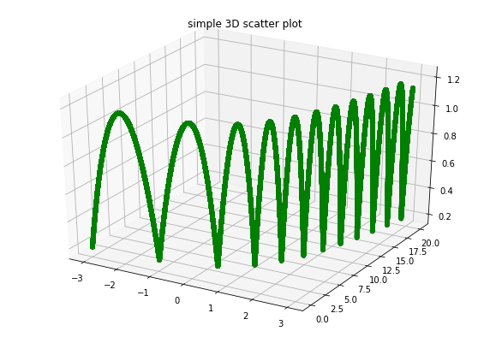
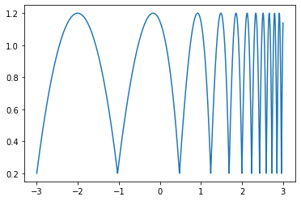
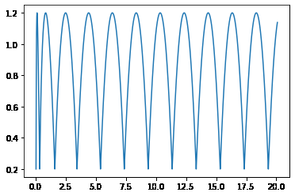
VISUALIZING THE RESULTS
In 2D plane
y = exp(x)
Graph of z vs x
Graph of z vs y
Plotting x,y,z in 3D

Slide 9
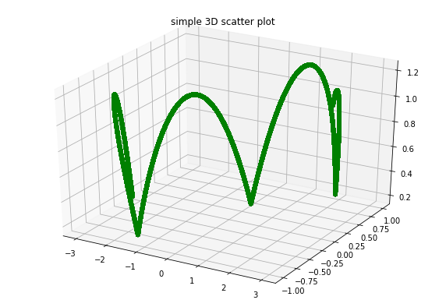
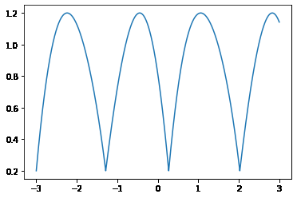
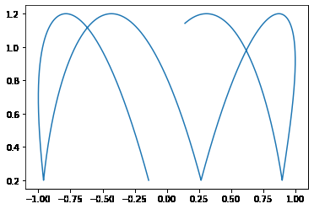
VISUALIZING THE RESULTS
In 2D plane
y = sin(x)
Graph of z vs x
Graph of z vs y
Plotting x,y,z in 3D

Slide 10
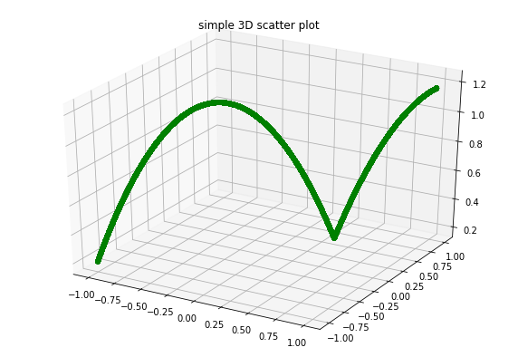
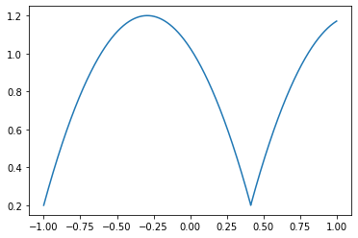
VISUALIZING THE RESULTS
In 2D plane
y = x
Graph of z vs x
Graph of z vs y
Plotting x,y,z in 3D

Slide 11
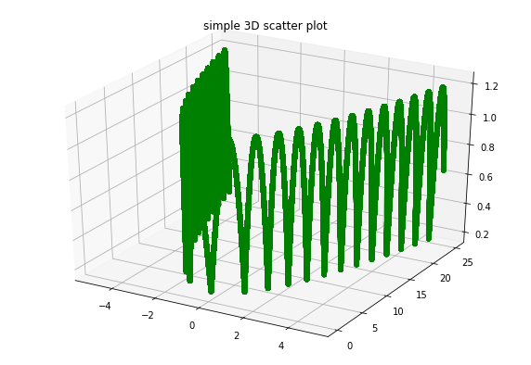
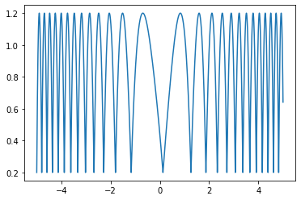
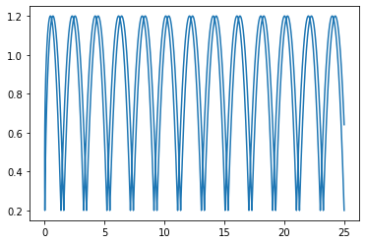
VISUALIZING THE RESULTS
In 2D plane
y = x^2
Graph of z vs x
Graph of z vs y
Plotting x,y,z in 3D

Slide 12
CONCLUSION
Calculating the mass deposited in single pass or multi-pass welding allows us to optimize various process parameters like rate of heat input, wider heat distribution, higher resolution and optimum yield.
The results obtained in the project can be used to calculate height, and thus the mass, for welding along different 2D planes
The bead’s geometry was modeled assuming it as a parabola, which has been validated experimentally. The advantage of this model is that the bead’s geometry can be inferred by merely measuring its height, instead of performing cumbersome calculations

Slide 13
ACKNOWLEDGEMENT
I would like to thank our course instructor Dr. Sajan Kapil sir for assigning me this interesting project. It was a great learning experience and I would like to thank sir for constantly guiding me during the progress of this project as well as the course.
I would also like to thank Ritam Sarma sir for guiding me over phone calls and providing me resources to better understand this project.

Slide 14
REFERENCES
The research paper :
“Weld bead modeling and process optimization in Hybrid
Layered Manufacturing”
GeeksforGeeks
Matplotlib documentation

